Slide 1
3-Bit One-Hot Up/Down Counter
In this type of counter, there is an input that dictates whether the counter increments or decrements.
This counter can still be implemented as a Moore machine and use state-encoded outputs.

Slide 2
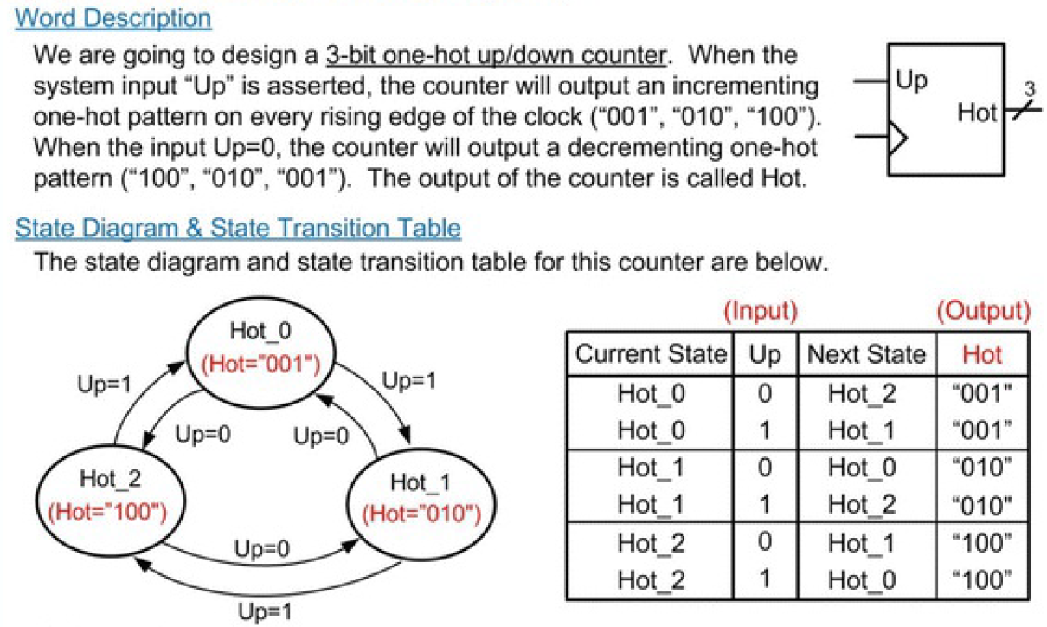

Slide 3
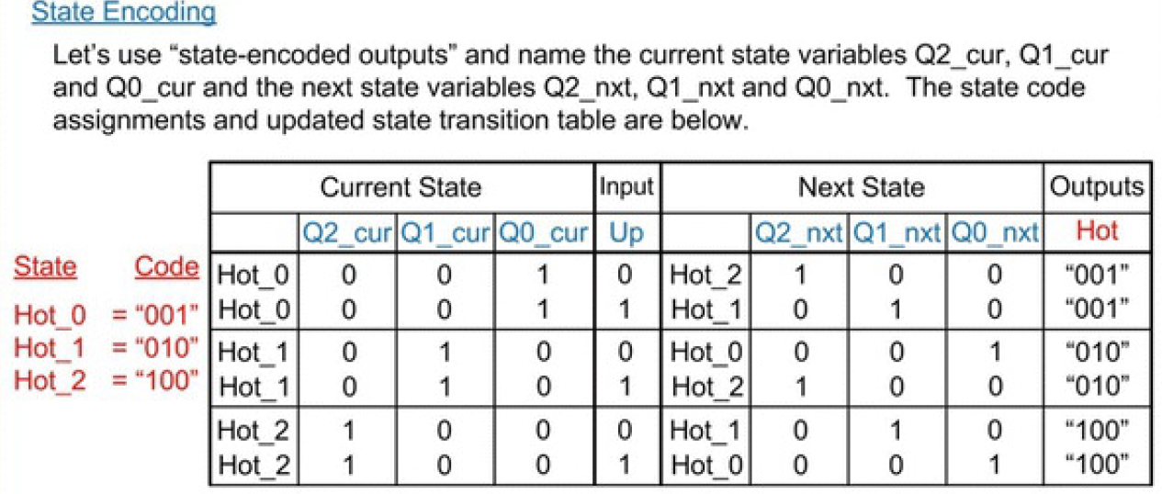

Slide 4
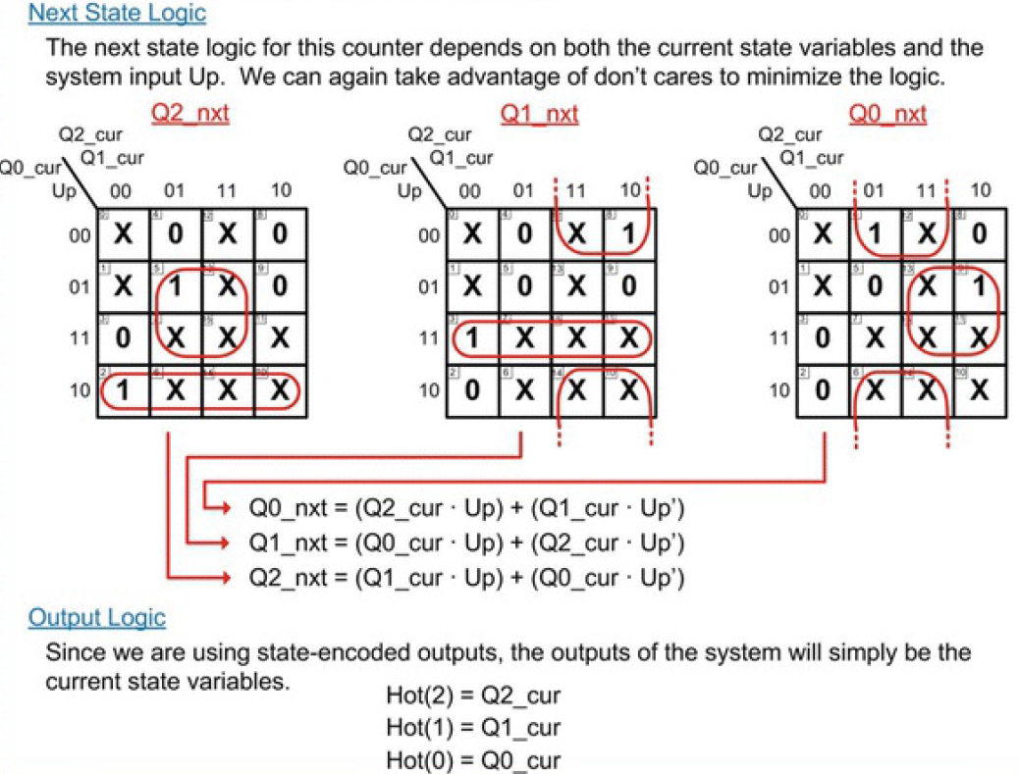

Slide 5
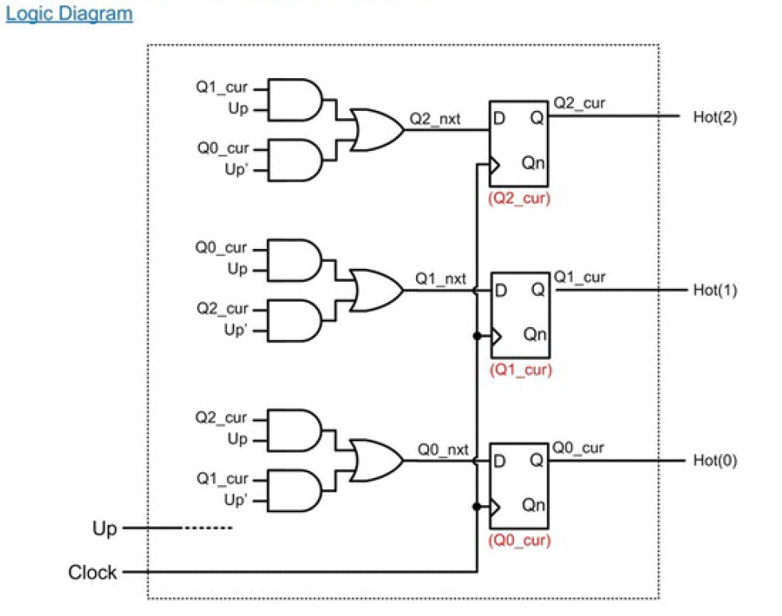

Slide 6
